Slide 1
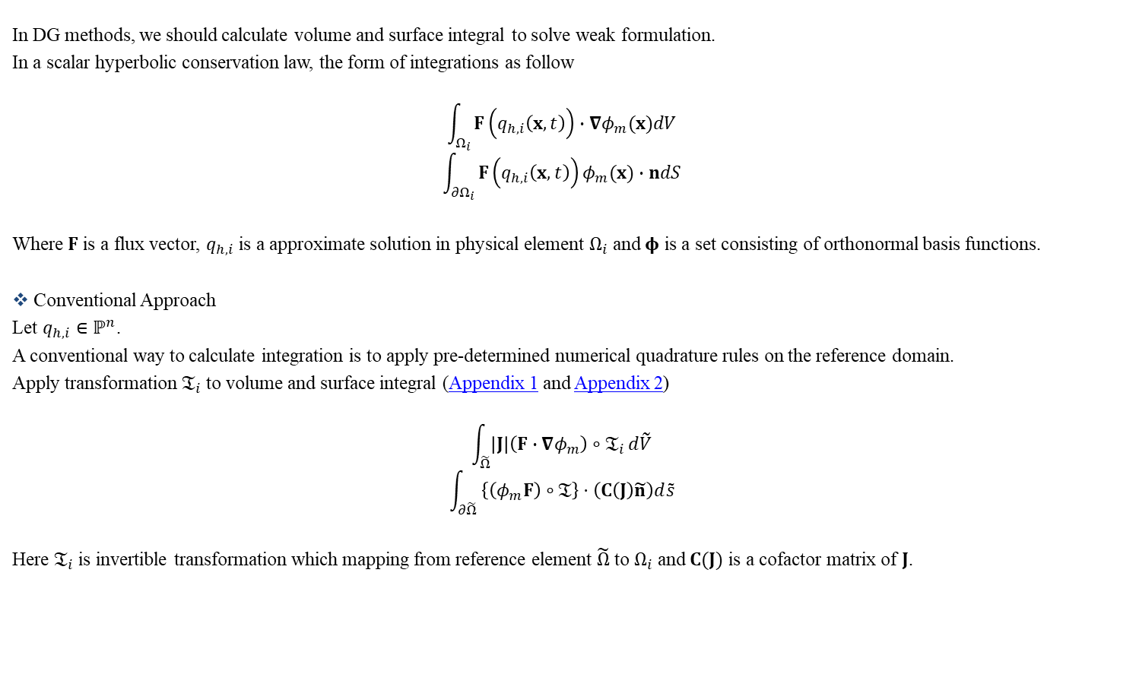
Numerical Integration on High-order Curved Elements
In DG methods, we should calculate volume and surface integral to solve weak formulation.
In a scalar hyperbolic conservation law, the form of integrations as follow
$$\int_{Ω_{i}}{F\left(q_{h,i}\left(x,t\right)\right)∙∇φ_{m}(x)dV}$$
$$\int_{{∂Ω}_{i}}{F\left(q_{h,i}\left(x,t\right)\right)φ_{m}(x)∙ndS}$$
Where $F$ is a flux vector, $q_{h,i}$ is a approximate solution in physical element $Ω_{i}$ and $φ$ is a set consisting of orthonormal basis functions.
Conventional Approach
Let $q_{h,i}∈ℙ^{n}$.
A conventional way to calculate integration is to apply pre-determined numerical quadrature rules on the reference domain.
Apply transformation $𝔗_{i}$ to volume and surface integral (Appendix 1 and Appendix 2)
$$\int_{\tilde{Ω}}{\left|J\right|\left(F∙∇φ_{m}\right)∘𝔗_{i}}d\tilde{V}$$
$$\int_{∂\tilde{Ω}}{ \left\{\left(φ_{m}F\right)∘𝔗\right\}⋅\left(C\left(J\right)\tilde{n}\right)d\tilde{s}}$$
Here $𝔗_{i}$ is invertible transformation which mapping from reference element $\tilde{Ω}$ to $Ω_{i}$ and $C(J)$ is a cofactor matrix of $J$.

Slide 2
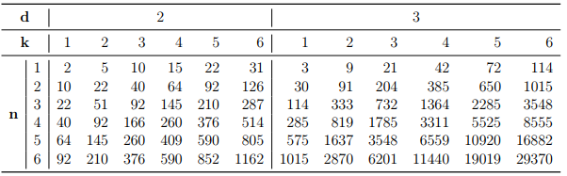

Numerical Integration on High-order Curved Elements
For $ℙ^{n}$ simplex elements, $𝔗_{i}(r)∈ℙ^{n}(r)$ (Appendix 3).
Thus we can calculate order of integrand polynomials as follow (Appendix 4 and Appendix 5)
$$\left|J\right|\left(F∙∇ψ_{m}\right)∈𝒫^{2kn+d(n−1)}=𝒫^{O_{v}}$$
$$\left\{\left(ψ_{m}F\right)∘𝔗\right\}⋅\left(C\left(J\right)\tilde{n}\right)∈𝒫^{2kn+d\left(n−1\right)+1}=𝒫^{O_{s}}$$
Here $𝒫^{n}$ is a set of arbitrary polynomial order equal to $n$and $O_{v},O_{s}$ mean polynomial order of integrand in volume and surface integral each.
From this we can estimate possible minimum number of quadrature points $N_{q,v}$ and $N_{q,s}$ (Appendix 6) as follow
$$\frac{ _{O_{v}+d}C_{ d}}{\left(d+1\right)}≤N_{q,v}$$
$$\frac{ _{O_{s}+d}C_{ d}}{O_{s}+d}≤N_{q,s}$$
$N_{q,v}$ is tabled below

Slide 3
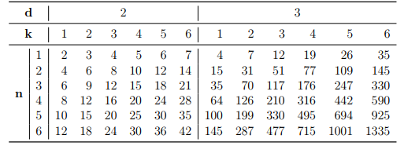

Numerical Integration on High-order Curved Elements
$N_{q,s}$ is tabled below
Direct Quadrature Methods(DQM) for Volume Integration
Let $q_{h,i}$ is polynomial order $n$.
Since $F$ should be greater than $N+1 th$ order polynomial to satisfy formal order of accuracy, we can assume $F⋅∇φ∈𝒫^{2n}(Ω_{i})$.
Find an orthonormal basis set $φ_{i}$ of $𝒫^{2n}(Ω_{i})$ by using the MGS process.

Slide 4

Transformation and Jacobian
Let $\tilde{Ω}$ be reference element and $Ω_{i}$ be physical element.
Let
$$𝔗_{i}:r=\left(u,v\right)∈\tilde{Ω}↦x=\left(x,y\right)∈Ω_{i}$$
$$𝔗_{i}:x=Ar+b$$
Define Jacobian matrix $J$ as $dx=Jdr$
$$\left(\begin{matrix}dx \\ dy\end{matrix}\right)=\left[\begin{matrix}\frac{∂x}{∂u} & \frac{∂x}{∂v} \\ \frac{∂y}{∂u} & \frac{∂y}{∂v}\end{matrix}\right]\left(\begin{matrix}du \\ dv\end{matrix}\right)$$
If $A$ is constant
$$\frac{∂x}{∂r}=\frac{∂Ar}{∂r}+\frac{∂b}{∂r}⇒J=A\frac{∂r}{∂r}⇒J=A$$
$$⇒J^{−1}=A^{−1}$$

Slide 5





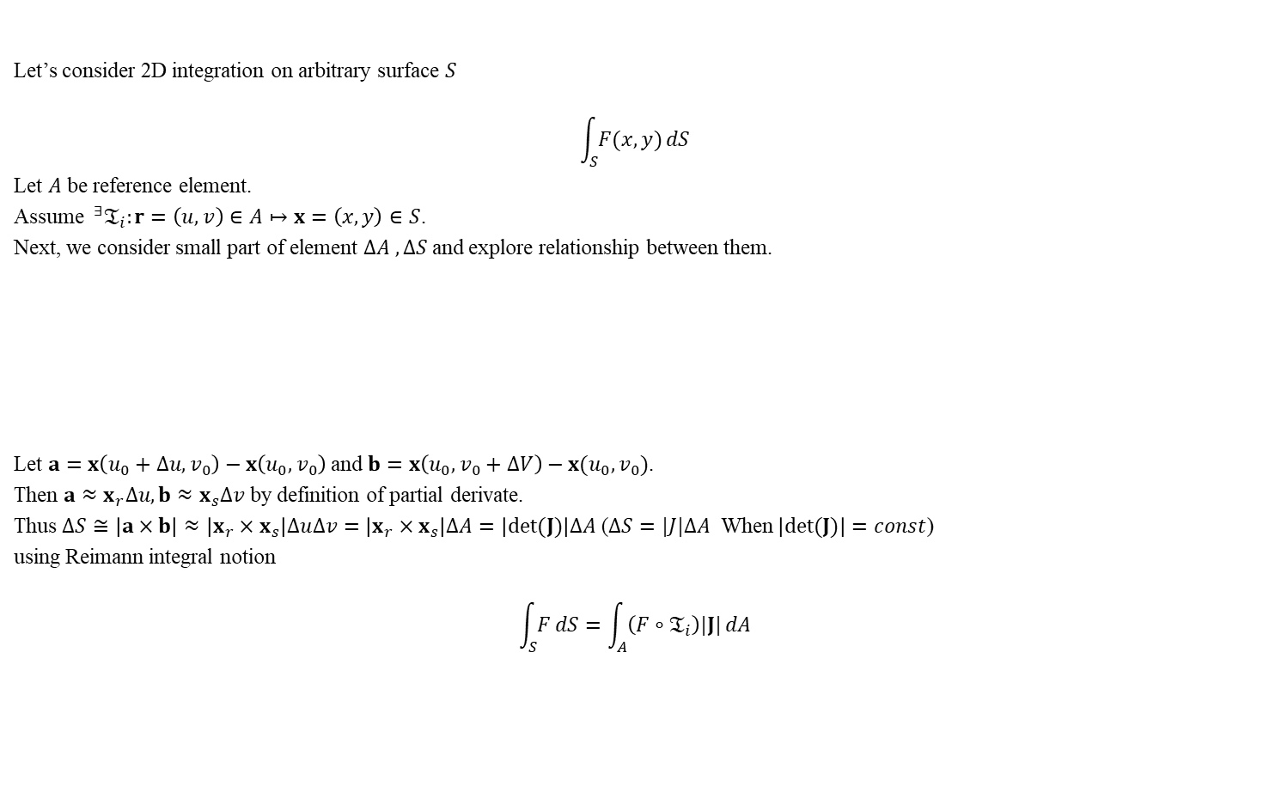








Appendix 1 Integral Domain Transformation of Volume Integral
Let’s consider 2D integration on arbitrary surface $S$
$$\int_{S}{F(x,y)}dS$$
Let $A$ be reference element.
Assume $^{∃}𝔗_{i}:r=\left(u,v\right)∈A↦x=\left(x,y\right)∈S$.
Next, we consider small part of element $∆A , ∆S$ and explore relationship between them.
Let $a=x\left(u_{0}+∆u,v_{0}\right)−x\left(u_{0},v_{0}\right)$ and $b=x\left(u_{0},v_{0}+∆V\right)−x(u_{0},v_{0})$.
Then $a≈x_{r}∆u, b≈x_{s}∆v$ by definition of partial derivate.
Thus $∆S≅\left|a×b\right|≈\left|x_{r}×x_{s}\right|∆u∆v=\left|x_{r}×x_{s}\right|∆A=\left|det⁡(J)\right|∆A$ ($∆S=|J|∆A$ When $\left|det(J)\right|=const$)
using Reimann integral notion
$$\int_{S}{F}dS=\int_{A}{\left(F∘𝔗_{i}\right)|J|}dA$$
$$v$$
$$∆u$$
$$y$$
$$∆A$$
$∆$S
$$∆v$$
$$𝔗_{i}$$
$$b$$
$$\left(u_{0},v_{0}\right)$$
$$\left(x_{0},y_{0}\right)$$
$$a$$
$$u$$
$$x$$

Slide 6
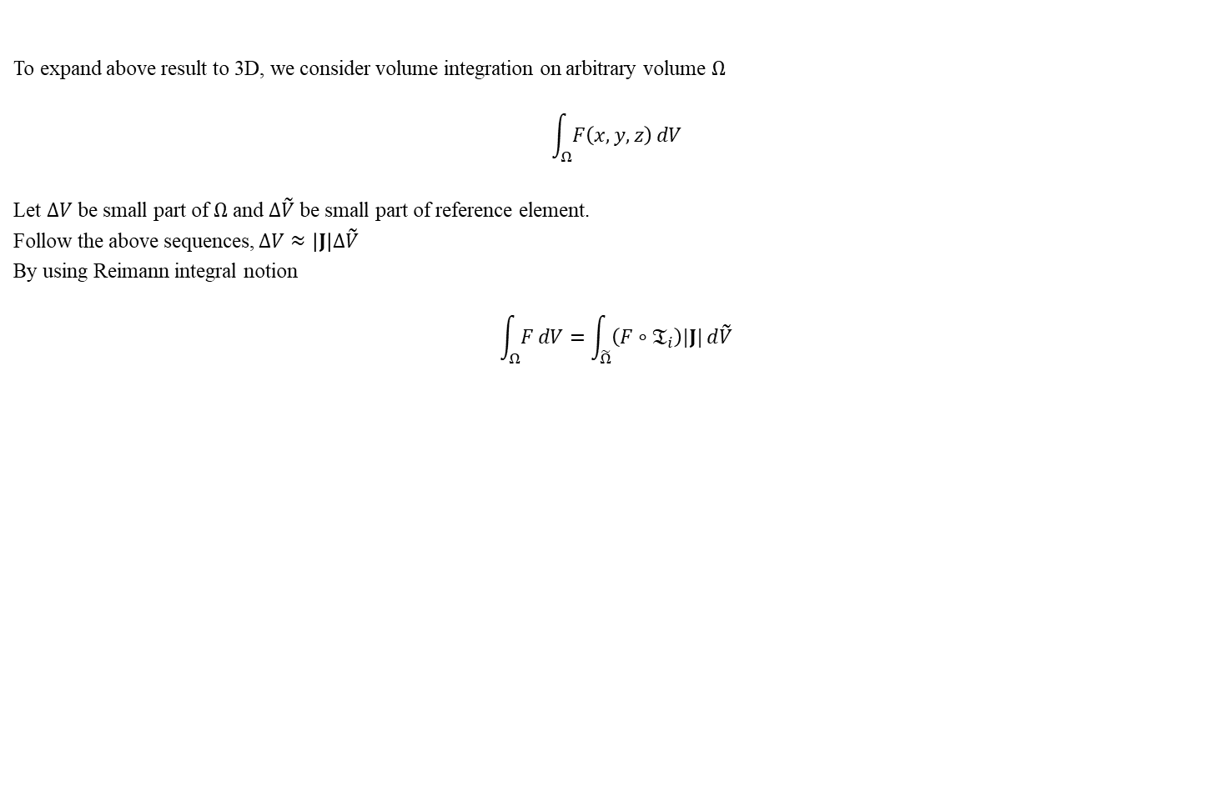
Appendix 1 Transformation of Volume Integral
To expand above result to 3D, we consider volume integration on arbitrary volume $Ω$
$$\int_{Ω}{F\left(x,y,z\right)}dV$$
Let $∆V$ be small part of $Ω$ and $∆\tilde{V}$ be small part of reference element.
Follow the above sequences, $∆V≈\left|J\right|∆\tilde{V}$
By using Reimann integral notion
$$\int_{Ω}{F}dV=\int_{\tilde{Ω}}{\left(F∘𝔗_{i}\right)|J|}d\tilde{V}$$

Slide 7
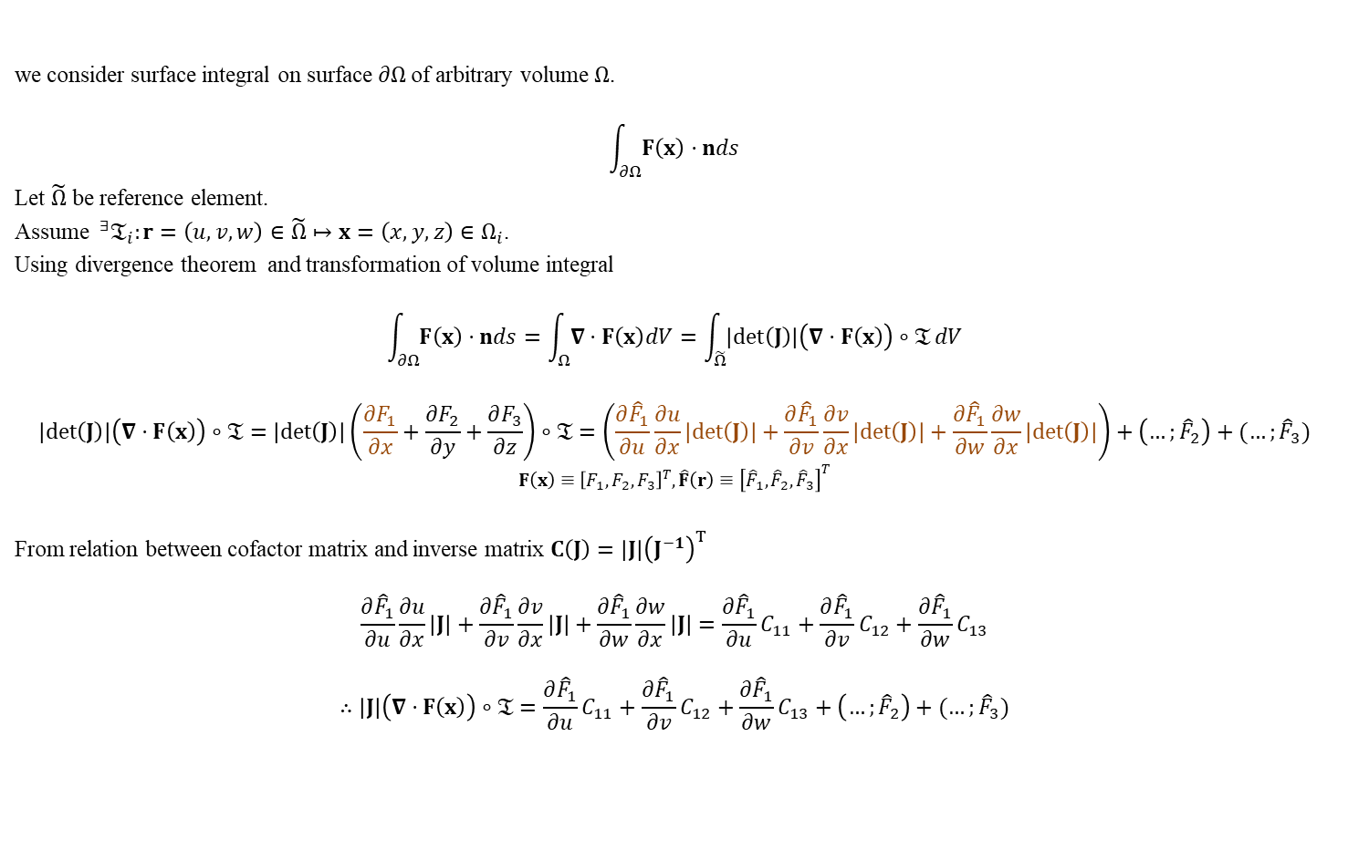
Appendix 2 Transformation of Surface Integral
we consider surface integral on surface $∂Ω$of arbitrary volume $Ω$.
$$\int_{∂Ω}{F\left(x\right)⋅nds}$$
Let $\tilde{Ω}$ be reference element.
Assume $^{∃}𝔗_{i}:r=\left(u,v,w\right)∈\tilde{Ω}↦x=\left(x,y,z\right)∈Ω_{i}$.
Using divergence theorem and transformation of volume integral
$$\int_{∂Ω}{F\left(x\right)⋅nds}=\int_{Ω}{∇⋅F\left(x\right)dV}=\int_{\tilde{Ω}}{\left|det\left(J\right)\right|\left(∇⋅F\left(x\right)\right)∘𝔗}dV$$
$$\left|det\left(J\right)\right|\left(∇⋅F\left(x\right)\right)∘𝔗=\left|det\left(J\right)\right|\left(\frac{∂F_{1}}{∂x}+\frac{∂F_{2}}{∂y}+\frac{∂F_{3}}{∂z}\right)∘𝔗=\left(\frac{∂{\hat{F}}_{1}}{∂u}\frac{∂u}{∂x}\left|det\left(J\right)\right|+\frac{∂{\hat{F}}_{1}}{∂v}\frac{∂v}{∂x}\left|det\left(J\right)\right|+\frac{∂{\hat{F}}_{1}}{∂w}\frac{∂w}{∂x}\left|det\left(J\right)\right|\right)+\left(…;{\hat{F}}_{2}\right)+(…;{\hat{F}}_{3})$$
$$F\left(x\right)≡{\left[F_{1},F_{2},F_{3}\right]}^{T},\hat{F}\left(r\right)≡{\left[{\hat{F}}_{1},{\hat{F}}_{2},{\hat{F}}_{3}\right]}^{T}$$
From relation between cofactor matrix and inverse matrix $C\left(J\right)=\left|J\right|{\left(J^{−1}\right)}^{T}$
$$\frac{∂{\hat{F}}_{1}}{∂u}\frac{∂u}{∂x}\left|J\right|+\frac{∂{\hat{F}}_{1}}{∂v}\frac{∂v}{∂x}\left|J\right|+\frac{∂{\hat{F}}_{1}}{∂w}\frac{∂w}{∂x}\left|J\right|=\frac{∂{\hat{F}}_{1}}{∂u}C_{11}+\frac{∂{\hat{F}}_{1}}{∂v}C_{12}+\frac{∂{\hat{F}}_{1}}{∂w}C_{13}$$
$$∴\left|J\right|\left(∇⋅F\left(x\right)\right)∘𝔗=\frac{∂{\hat{F}}_{1}}{∂u}C_{11}+\frac{∂{\hat{F}}_{1}}{∂v}C_{12}+\frac{∂{\hat{F}}_{1}}{∂w}C_{13}+\left(…;{\hat{F}}_{2}\right)+(…;{\hat{F}}_{3})$$

Slide 8
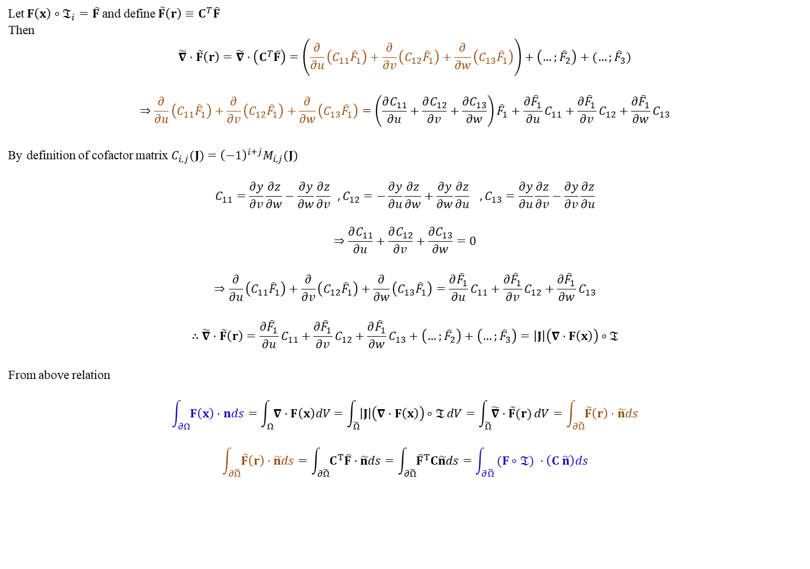
Appendix 2 Transformation of Surface Integral
Let$F\left(x\right)∘𝔗_{i}=\hat{F}$ and define $\tilde{F}\left(r\right)≡C^{T}\hat{F}$
Then
$$\tilde{∇}⋅\tilde{F}\left(r\right)=\tilde{∇}⋅\left(C^{T}\hat{F}\right)=\left(\frac{∂}{∂u}\left(C_{11}{\hat{F}}_{1}\right)+\frac{∂}{∂v}\left(C_{12}{\hat{F}}_{1}\right)+\frac{∂}{∂w}\left(C_{13}{\hat{F}}_{1}\right)\right)+\left(…;{\hat{F}}_{2}\right)+(…;{\hat{F}}_{3})$$
$$⇒\frac{∂}{∂u}\left(C_{11}{\hat{F}}_{1}\right)+\frac{∂}{∂v}\left(C_{12}{\hat{F}}_{1}\right)+\frac{∂}{∂w}\left(C_{13}{\hat{F}}_{1}\right)=\left(\frac{∂C_{11}}{∂u}+\frac{∂C_{12}}{∂v}+\frac{∂C_{13}}{∂w}\right){\hat{F}}_{1}+\frac{∂{\hat{F}}_{1}}{∂u}C_{11}+\frac{∂{\hat{F}}_{1}}{∂v}C_{12}+\frac{∂{\hat{F}}_{1}}{∂w}C_{13}$$
By definition of cofactor matrix $C_{i,j}(J)={\left(−1\right)}^{i+j}M_{i,j}(J)$
$$C_{11}=\frac{∂y}{∂v}\frac{∂z}{∂w}−\frac{∂y}{∂w}\frac{∂z}{∂v} ,C_{12}=−\frac{∂y}{∂u}\frac{∂z}{∂w}+\frac{∂y}{∂w}\frac{∂z}{∂u} ,C_{13}=\frac{∂y}{∂u}\frac{∂z}{∂v}−\frac{∂y}{∂v}\frac{∂z}{∂u}$$
$$⇒\frac{∂C_{11}}{∂u}+\frac{∂C_{12}}{∂v}+\frac{∂C_{13}}{∂w}=0$$
$$⇒\frac{∂}{∂u}\left(C_{11}{\hat{F}}_{1}\right)+\frac{∂}{∂v}\left(C_{12}{\hat{F}}_{1}\right)+\frac{∂}{∂w}\left(C_{13}{\hat{F}}_{1}\right)=\frac{∂{\hat{F}}_{1}}{∂u}C_{11}+\frac{∂{\hat{F}}_{1}}{∂v}C_{12}+\frac{∂{\hat{F}}_{1}}{∂w}C_{13}$$
$$∴\tilde{∇}⋅\tilde{F}\left(r\right)=\frac{∂{\hat{F}}_{1}}{∂u}C_{11}+\frac{∂{\hat{F}}_{1}}{∂v}C_{12}+\frac{∂{\hat{F}}_{1}}{∂w}C_{13}+\left(…;{\hat{F}}_{2}\right)+\left(…;{\hat{F}}_{3}\right)=\left|J\right|\left(∇⋅F\left(x\right)\right)∘𝔗$$
From above relation
$$\int_{∂Ω}{F\left(x\right)⋅nds}=\int_{Ω}{∇⋅F\left(x\right)dV}=\int_{\tilde{Ω}}{\left|J\right|\left(∇⋅F\left(x\right)\right)∘𝔗}dV=\int_{\tilde{Ω}}{\tilde{∇}⋅\tilde{F}(r)}dV=\int_{∂\tilde{Ω}}{\tilde{F}\left(r\right)⋅\tilde{n}ds}$$
$$\int_{∂\tilde{Ω}}{\tilde{F}\left(r\right)⋅\tilde{n}ds}=\int_{∂\tilde{Ω}}{C^{T}\hat{F}⋅\tilde{n}ds}=\int_{∂\tilde{Ω}}{{\hat{F}}^{T}C\tilde{n}ds}=\int_{∂\tilde{Ω}}{ (F∘𝔗) ⋅\left(C \tilde{n}\right)ds}$$

Slide 9















Appendix 2.1 Transformation of Surface Normal Vector
We consider surface normal vector $\tilde{n}$ in reference element $\tilde{Ω}$ which is tangent to the surface at $r$.
Then we assume there is a invertible transformation operator $𝔗_{i}$ which mapping from reference element $\tilde{Ω}$ to physical element $Ω$.
$$𝔗_{i}:r=\left(u,v,w\right)∈\tilde{Ω}↦x=\left(x,y,z\right)∈Ω_{ }$$
$$x=x(r)$$
Then we want to know surface normal vector $n$ in physical element which is tangent to the surface at $x$.
Unfortunately, it can’t be obtained by simple transformation
$$𝔗_{i}\left(\tilde{n}\right)≠n$$
To get surface normal vector $n$ in physical element, we use the fact that $n$ is tangent to the surface at $x$.
First we define infinitesimally small vector $∆r$ in $Ω_{i}$
$$∆r=r_{n}−r$$
$$η$$
$$\tilde{n}$$
$$y$$
$$∆r$$
$$Ω_{ }$$
$$n$$
$$r$$
$$r_{n}$$
$$𝔗_{i}$$
$$x$$
$$∆x$$
$$\tilde{Ω}$$
$$x_{n}$$
$$ξ$$
$$x$$

Slide 10

Appendix 2.1 Transformation of Surface Normal Vector
Since we assume infinitesimally small $∆r$ we can safely say
$$∆r⋅\tilde{n}=0$$
and
$$∆x≅J(r)∆r$$
From the fact that $n$ and $∆x$ must be orthogonal
$$∆x⋅n=\left(J\left(r\right)∆r\right)⋅n={\left(∆r\right)}^{T}J{\left(r\right)}^{T}n=0$$
To satisfy above relation
$$n={\left(J{\left(r\right)}^{T}\right)}^{−1}\tilde{n}$$
Normalize it
$$\frac{n}{\left\|n\right\|}=\frac{{\left(J{\left(r\right)}^{T}\right)}^{−1}\tilde{n}}{\left\|{\left(J{\left(r\right)}^{T}\right)}^{−1}\tilde{n}\right\|}=\frac{det(J){\left(J{\left(r\right)}^{T}\right)}^{−1}\tilde{n}}{det(J)\left\|{\left(J{\left(r\right)}^{T}\right)}^{−1}\tilde{n}\right\|}=\frac{C\tilde{n}}{\left\|C\tilde{n}\right\|}$$

Slide 11


Appendix 3 Transformation Consists of $P_{n}$ Polynomial
Let’s consider invertible transformation operator $𝔗_{i}$ which mapping from reference element $\tilde{Ω}$ to physical element $Ω_{i}$.
$$𝔗_{i}:r=\left(u,v\right)∈\tilde{Ω}↦x=\left(x,y\right)∈Ω_{i}$$
$$𝔗\left(r\right)=Ar+b$$
If $𝔗$ consists of $1 st$ order polynomials
$$x,y=f\left(u,v\right)=c_{0}u+c_{1}v+c_{2}∈ℙ^{1}(r)$$
$$c_{n}:constatnt$$
$$A:constnat matrix$$
If $𝔗$ consists of $2 nd$ order polynomials
$$x,y=f\left(u,v\right)=c_{0}u^{2}+c_{1}v^{2}+c_{2}uv+c_{3}u+c_{4}v+c_{5}∈ℙ^{2}(r)$$
$$c_{n}:constatnt$$
$$A=A(u,v)$$
Every $𝔗_{i}$ consists of $n th$ order polynomials make simplex elements to high order curved $P_{n}$ simplex elements.
But Every $𝔗$ consists of $n th$ order polynomials doesn’t make nom-simplex elements to high order curved $P_{n}$ non-simplex elements.

Slide 12

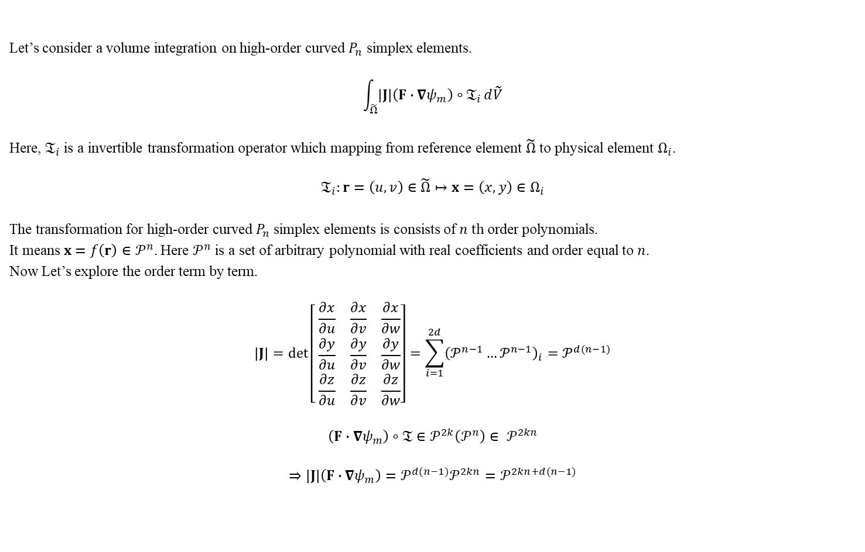
Appendix 4 Order of Integrand in Numerical Volume Integral
Let’s consider a volume integration on high-order curved $P_{n}$ simplex elements.
$$\int_{\tilde{Ω}}{\left|J\right|\left(F∙∇ψ_{m}\right)∘𝔗_{i}}d\tilde{V}$$
Here, $𝔗_{i}$ is a invertible transformation operator which mapping from reference element $\tilde{Ω}$ to physical element $Ω_{i}$.
$$𝔗_{i}:r=\left(u,v\right)∈\tilde{Ω}↦x=\left(x,y\right)∈Ω_{i}$$
The transformation for high-order curved $P_{n}$ simplex elements is consists of $n th$ order polynomials.
It means$x=f\left(r\right)∈𝒫^{n}$. Here $𝒫^{n}$ is a set of arbitrary polynomial with real coefficients and order equal to $n$.
Now Let’s explore the order term by term.
$$\left|J\right|=\det\left[ \begin{matrix}\frac{∂x}{∂u} & \frac{∂x}{∂v} & \frac{∂x}{∂w} \\ \frac{∂y}{∂u} & \frac{∂y}{∂v} & \frac{∂y}{∂w} \\ \frac{∂z}{∂u} & \frac{∂z}{∂v} & \frac{∂z}{∂w}\end{matrix}\right]=\sum_{i=1}^{2d}{{\left(𝒫^{n−1}…𝒫^{n−1}\right)}_{i}}=𝒫^{d(n−1)}$$
$$\left(F∙∇ψ_{m}\right)∘𝔗∈𝒫^{2k}\left(𝒫^{n}\right)∈ 𝒫^{2kn}$$
$$⇒\left|J\right|\left(F∙∇ψ_{m}\right)=𝒫^{d(n−1)}𝒫^{2kn}=𝒫^{2kn+d(n−1)}$$
$$d$$

Slide 13
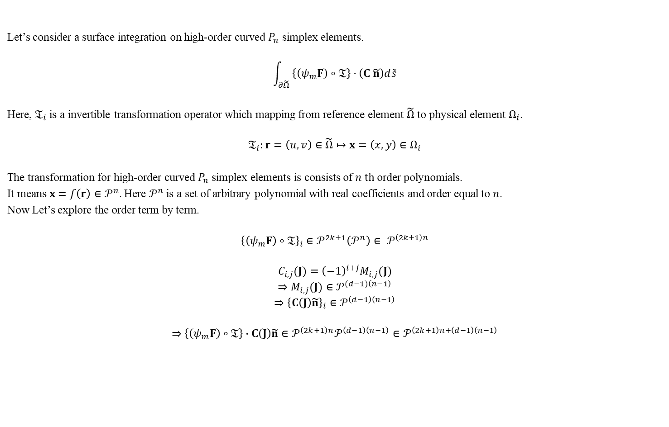
Appendix 5 Order of Integrand in Numerical Surface Integral
Let’s consider a surface integration on high-order curved $P_{n}$ simplex elements.
$$\int_{∂\tilde{Ω}}{ \left\{\left(ψ_{m}F\right)∘𝔗\right\}⋅\left(C \tilde{n}\right)d\tilde{s}}$$
Here, $𝔗_{i}$ is a invertible transformation operator which mapping from reference element $\tilde{Ω}$ to physical element $Ω_{i}$.
$$𝔗_{i}:r=\left(u,v\right)∈\tilde{Ω}↦x=\left(x,y\right)∈Ω_{i}$$
The transformation for high-order curved $P_{n}$ simplex elements is consists of $n th$ order polynomials.
It means$x=f\left(r\right)∈𝒫^{n}$. Here $𝒫^{n}$ is a set of arbitrary polynomial with real coefficients and order equal to $n$.
Now Let’s explore the order term by term.
$${\left\{\left(ψ_{m}F\right)∘𝔗\right\}}_{i}∈𝒫^{2k+1}\left(𝒫^{n}\right)∈ 𝒫^{\left(2k+1\right)n}$$
$$C_{i,j}(J)={\left(−1\right)}^{i+j}M_{i,j}(J)$$
$$⇒M_{i,j}(J)∈𝒫^{(d−1)\left(n−1\right)}$$
$$⇒{\left\{C\left(J\right)\tilde{n}\right\}}_{i}∈𝒫^{\left(d−1\right)\left(n−1\right)}$$
$$⇒\left\{\left(ψ_{m}F\right)∘𝔗\right\}∙C\left(J\right)\tilde{n}∈𝒫^{\left(2k+1\right)n}𝒫^{\left(d−1\right)\left(n−1\right)}∈𝒫^{\left(2k+1\right)n+\left(d−1\right)\left(n−1\right)}$$

Slide 14
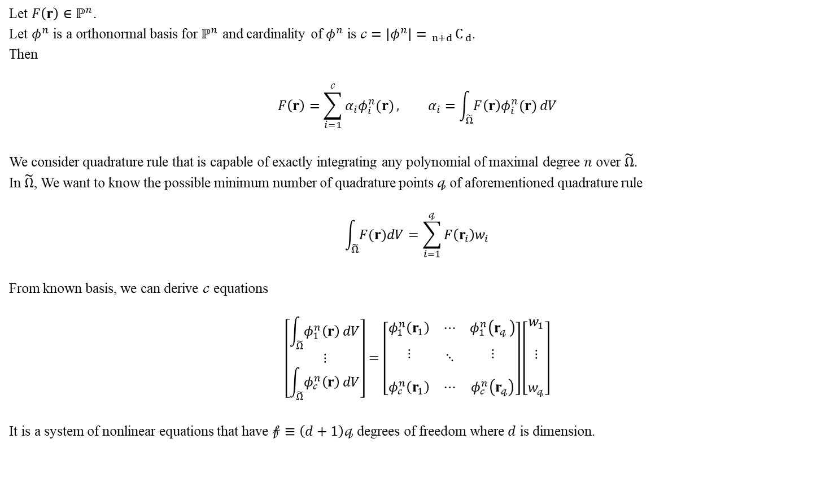
Appendix 6 Possible Minimum Number of Quadrature Points
Let $F\left(r\right)∈ℙ^{n}$.
Let $φ^{n}$ is a orthonormal basis for $ℙ^{n}$ and cardinality of $φ^{n}$ is $𝒸=\left|φ^{n}\right|= _{n+d}C_{ d}$.
Then
$$F\left(r\right)=\sum_{i=1}^{𝒸}{α_{i}φ_{i}^{n}(r)}, α_{i}=\int_{\tilde{Ω}}{F\left(r\right)φ_{i}^{n}(r)}dV$$
We consider quadrature rule that is capable of exactly integrating any polynomial of maximal degree $n$ over $\tilde{Ω}$.
In $\tilde{Ω}$, We want to know the possible minimum number of quadrature points $𝓆$ of aforementioned quadrature rule
$$\int_{\tilde{Ω}}{F(r)dV}=\sum_{i=1}^{𝓆}{F\left(r_{i}\right)w_{i}}$$
From known basis, we can derive $𝒸$ equations
$$\left[\begin{aligned}\int_{\tilde{Ω}}{φ_{1}^{n}\left(r\right)}dV \\ ⋮ \\ \int_{\tilde{Ω}}{φ_{𝒸}^{n}\left(r\right)}dV\end{aligned}\right]=\left[\begin{matrix}φ_{1}^{n}\left(r_{1}\right) & ⋯ & φ_{1}^{n}\left(r_{𝓆 }\right) \\ \begin{aligned} \\ ⋮ \\ \end{aligned} & ⋱ & \begin{aligned} \\ ⋮ \\ \end{aligned} \\ φ_{𝒸}^{n}\left(r_{1}\right) & ⋯ & φ_{𝒸}^{n}\left(r_{𝓆}\right)\end{matrix}\right]\left[\begin{aligned}w_{1} \\ \\ ⋮ \\ \\ w_{𝓆}\end{aligned}\right]$$
It is a system of nonlinear equations that have $𝒻≡\left(d+1\right)𝓆$ degrees of freedom where $d$ is dimension.

Slide 15
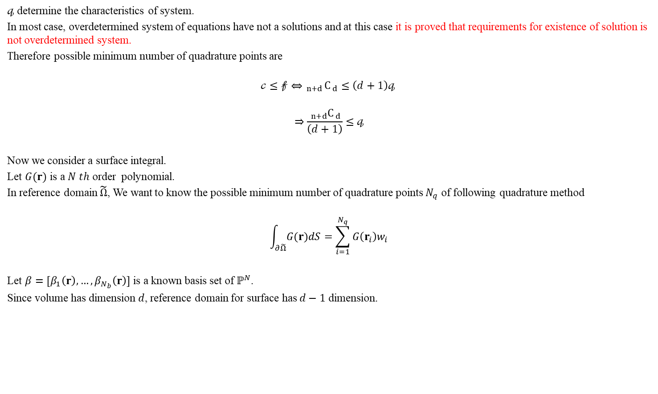
Appendix 6 Possible Minimum Number of Quadrature Points
$𝓆$ determine the characteristics of system.
In most case, overdetermined system of equations have not a solutions and at this case it is proved that requirements for existence of solution is not overdetermined system.
Therefore possible minimum number of quadrature points are
$$𝒸≤𝒻⇔ _{n+d}C_{ d}≤\left(d+1\right)𝓆$$
$$⇒\frac{ _{n+d}C_{ d}}{\left(d+1\right)}≤𝓆$$
Now we consider a surface integral.
Let $G(r)$ is a $N th$ order polynomial.
In reference domain $\tilde{Ω}$, We want to know the possible minimum number of quadrature points $N_{q}$ of following quadrature method
$$\int_{∂\tilde{Ω}}{G(r)dS}=\sum_{i=1}^{N_{q}}{G\left(r_{i}\right)w_{i}}$$
Let $β=[β_{1}\left(r\right),…,β_{N_{b}}\left(r\right)]$ is a known basis set of $ℙ^{N}$.
Since volume has dimension $d$, reference domain for surface has $d−1$ dimension.

Slide 16

Appendix 6 Possible Minimum Number of Quadrature Points
From known basis, we can derive as many equations as number of basis $N_{b}$
$$\int_{∂\tilde{Ω}}{β_{1}\left(r\right)}dV=\sum_{i=1}^{N_{q}}{β_{1}\left(r_{i}\right)w_{i}}$$
$$⋮$$
$$\int_{∂\tilde{Ω}}{β_{N_{b}}\left(r\right)}dV=\sum_{i=1}^{N_{q}}{β_{N_{b}}\left(r_{i}\right)w_{i}}$$
$$N_{b}≡ _{n+d−1}C_{ d−1}$$
It is a system of equations that have $N_{u}≡dN_{q}$ unkowns.
In the same way, we can conclude the possible minimum number of quadrature points are
$$N_{b}≤N_{u}⇔ _{n+d−1}C_{ d−1}≤dN_{q}$$
$$⇒\frac{ _{n+d−1}C_{ d−1}}{d}≤N_{q}$$
$$⇒\frac{ _{n+d−1}C_{ d−1}}{d}=\frac{ _{n+d−1}C_{ d−1}}{d}\frac{n+d}{d}\frac{d}{n+d}=\frac{ _{n+d}C_{ d}}{n+d}$$
$$⇒\frac{ _{n+d}C_{ d}}{n+d}≤N_{q}$$

Slide 17
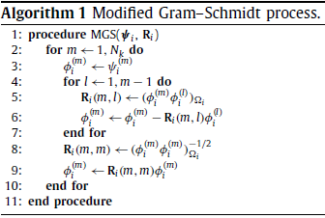

Appendix 7 Physical Domain Orthonormal Basis
We want to know physical domain orthonormal basis set $φ_{ }$ on element $Ω_{i}$.
First, Choose initial basis set $ψ_{i}$ as follow
$$ψ_{i}^{\left(m\right)}={\left(x−x_{c,i}\right)}^{r}{\left(y−y_{c,i}\right)}^{s}$$
$$\left(r,s\right)≥0 , r+s=k^{′} ,m=\frac{k^{′}\left(k^{′}+1\right)}{2}+r+1$$
$$\left(x_{c,i},y_{c,i}\right)≔coordinate of defined ceter of the element Ω_{i}$$
Now we use Classical Gram-Schmidt (CGS) process (Appendix 7.1).

Slide 18

Appendix 7 Physical Domain Orthonormal Basis
By Algorithm 1, coefficient matrix $R$ is calculated.
$$R= \left[\begin{matrix}\begin{matrix}R_{11} & & \\ & & \\ ⋮ & & ⋱ \end{matrix} & \begin{matrix} & & 0 \\ & & \\ & & \end{matrix} \\ \begin{matrix} & & \\ & & \\ R_{N1} & & …\end{matrix} & \begin{matrix} & & \\ & & \\ & & R_{NN}\end{matrix}\end{matrix}\right]$$
$$R_{ml}=\int_{Ω_{i}}{φ_{i}^{\left(m\right)}φ_{i}^{\left(l\right)}}dV=\int_{\tilde{Ω}}{\left|J\right|\left(φ_{i}^{\left(m\right)}φ_{i}^{\left(l\right)}\right)∘𝔗_{i}}dV$$
$$R_{mm}=\frac{1}{ \sqrt{\int_{Ω_{i}}{φ_{i}^{\left(m\right)}φ_{i}^{\left(m\right)}}dV}}=\frac{1}{ \sqrt{\int_{\tilde{Ω}}{\left|J\right|\left(φ_{i}^{\left(m\right)}φ_{i}^{\left(m\right)}\right)∘𝔗_{i}}dV}}$$
$$𝔗_{i}:r=\left(u,v\right)∈\tilde{Ω}↦x=\left(x,y\right)∈Ω_{i}$$
Write down few steps of Algorithm 1 with $R$
$$φ_{1}=ψ_{1}R_{11}$$
$$φ_{2}=\left(ψ_{2}−φ_{1}R_{21}\right)R_{22}=ψ_{2}R_{22} −ψ_{1}R_{11}R_{21}R_{22}$$
$$⋮$$

Slide 19
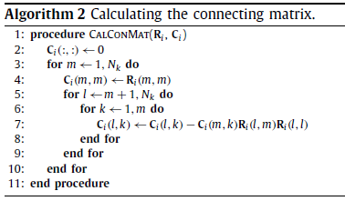

Appendix 7 Physical Domain Orthonormal Basis
From this we can find connecting matrix by Algorithm 2
Finally We can get $φ$ from monomial set $Ψ$ by pre-calculated $C$
$$φ=CΨ$$

Slide 20




Appendix 7.1 Gram-Schmidt procedure
$$x≔monomial$$
$$v≔orthogonal basis$$
$$q≔orthonomal basis$$
Non-normalized Classical Gram-Schmidt
for $j=1:n$
$v_{j}=x_{j}$
for $k=1:j−1$
$v_{j}=v_{j} −\frac{\left\langle v_{k},v_{j}\right\rangle }{\left\langle v_{k},v_{k}\right\rangle }v_{k}$
end for
end for
Output : orthogonal set $v$
Classical Gram-Schmidt (CGS)
for $j=1:n$
$v_{j}=x_{j}$
for $k=1:j−1$
$v_{j}=v_{j} −\left\langle v_{k},v_{j}\right\rangle v_{k}$
end for
$v_{j}=\frac{v_{j}}{{\left\|v_{j}\right\|}_{2}}$
end for
Output : orthonormal set $q$
Modified Gram-Schmidt (MGS)
for $j=1:n$
$v_{j}=x_{j}$
end for
for $j=1:n$
$q_{j}=\frac{v_{j}}{{\left\|v_{j}\right\|}_{2}}$
for $k=j+1:n$
$v_{k}=v_{k}−\left\langle q_{j},v_{k}\right\rangle q_{j}$
end for
end for
Output : orthonormal set $q$

Slide 21
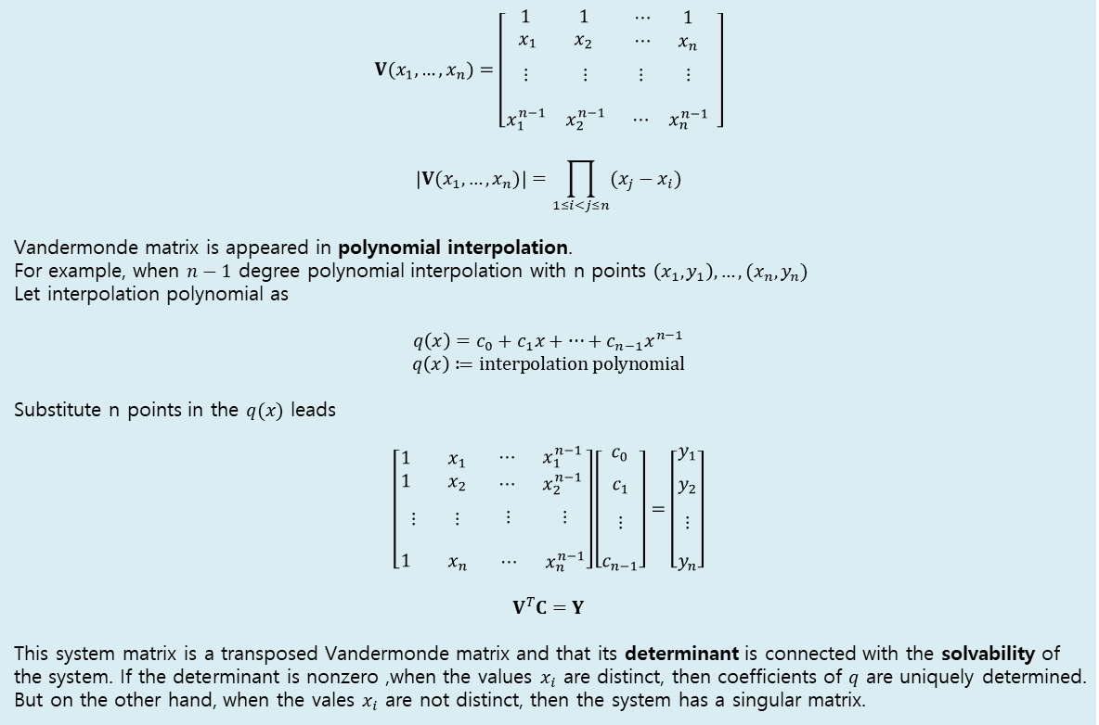
Vandermonde Matrix
$$V(x_{1},…,x_{n})=\left[\begin{matrix}\begin{matrix}1 & 1 \\ x_{\begin{aligned}1 \\ \end{aligned}} & x_{2}\end{matrix} & \begin{matrix} ⋯ & 1 \\ ⋯ & x_{n} \end{matrix} \\ \begin{matrix}\begin{aligned} \\ ⋮ \\ \end{aligned} & \begin{aligned} \\ ⋮ \\ \end{aligned} \\ x_{1}^{n−1} & x_{2}^{n−1}\end{matrix} & \begin{matrix}\begin{aligned} \\ ⋮ \\ \end{aligned} & \begin{aligned} \\ ⋮ \\ \end{aligned} \\ ⋯ & x_{n}^{n−1}\end{matrix}\end{matrix}\right]$$
$$\left|V(x_{1},…,x_{n})\right|=\prod_{1≤i<j≤n}{(x_{j}−x_{i})}$$
Vandermonde matrix is appeared in polynomial interpolation.
For example, when $n−1$ degree polynomial interpolation with n points $\left(x_{1},y_{1}\right),…,(x_{n},y_{n})$
Let interpolation polynomial as
$$q\left(x\right)=c_{0}+c_{1}x+…+c_{n−1}x^{n−1}$$
$$q\left(x\right)≔interpolation polynomial$$
Substitute n points in the $q(x)$ leads
$$\left[\begin{matrix}\begin{matrix}1 & x_{1} \\ 1 & x_{2}\end{matrix} & \begin{matrix} ⋯ & x_{1}^{n−1} \\ ⋯ & x_{2}^{n−1}\end{matrix} \\ \begin{matrix}\begin{aligned} \\ ⋮ \\ \end{aligned} & \begin{aligned} \\ ⋮ \\ \end{aligned} \\ 1 & x_{n}\end{matrix} & \begin{matrix} \begin{aligned} \\ ⋮ \\ \end{aligned} & \begin{aligned} \\ ⋮ \\ \end{aligned} \\ ⋯ & x_{n}^{n−1}\end{matrix}\end{matrix}\right]\left[\begin{matrix}c_{0} \\ \begin{aligned} \\ c_{1}\end{aligned} \\ \begin{matrix} \\ \begin{aligned} \\ ⋮ \\ \end{aligned} \\ c_{n−1}\end{matrix}\end{matrix}\right]=\left[\begin{matrix}y_{1} \\ \begin{aligned} \\ y_{2}\end{aligned} \\ \begin{matrix} \\ \begin{aligned} \\ ⋮ \\ \end{aligned} \\ y_{n}\end{matrix}\end{matrix}\right]$$
$$V^{T}C=Y$$
This system matrix is a transposed Vandermonde matrix and that its determinant is connected with the solvability of the system. If the determinant is nonzero ,when the values $x_{i}$ are distinct, then coefficients of $q$ are uniquely determined.
But on the other hand, when the vales $x_{i}$ are not distinct, then the system has a singular matrix.

Slide 22
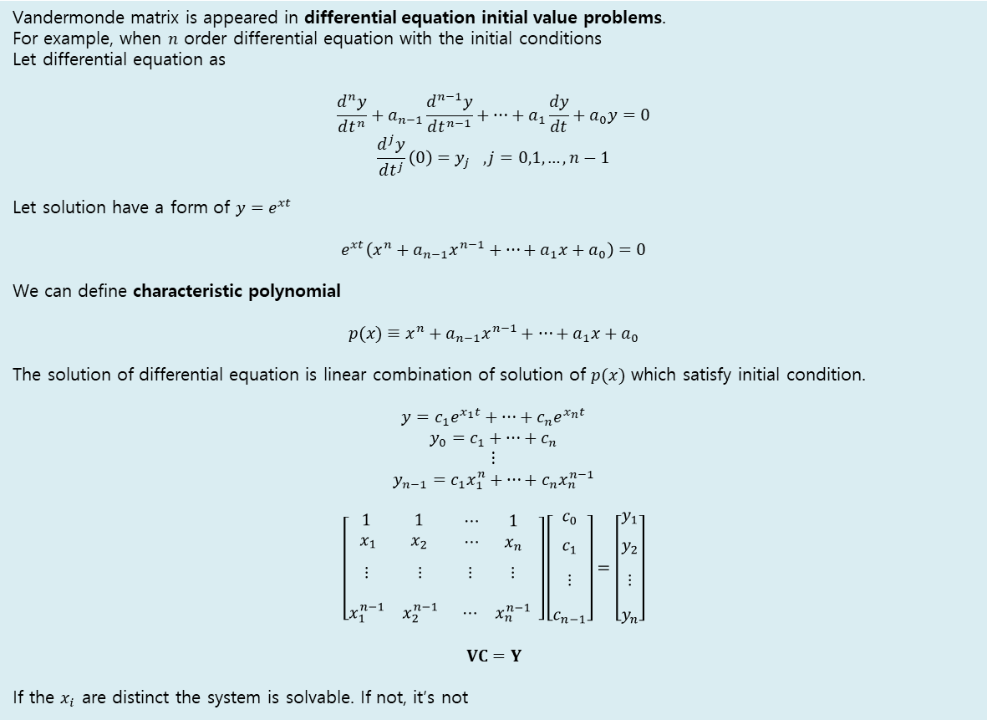
Vandermonde Matrix
Vandermonde matrix is appeared in differential equation initial value problems.
For example, when $n$ order differential equation with the initial conditions
Let differential equation as
$$\frac{d^{n}y}{dt^{n}}+a_{n−1}\frac{d^{n−1}y}{dt^{n−1}}+…+a_{1}\frac{dy}{dt}+a_{0}y=0$$
$$\frac{d^{j}y}{dt^{j}}\left(0\right)=y_{j} ,j=0,1,…,n−1$$
Let solution have a form of $y=e^{xt}$
$$e^{xt}\left(x^{n}+a_{n−1}x^{n−1}+…+a_{1}x+a_{0}\right)=0$$
We can define characteristic polynomial
$$p(x)≡x^{n}+a_{n−1}x^{n−1}+…+a_{1}x+a_{0}$$
The solution of differential equation is linear combination of solution of $p(x)$ which satisfy initial condition.
$$y=c_{1}e^{x_{1}t}+…+c_{n}e^{x_{n}t}$$
$$y_{0}=c_{1}+…+c_{n}$$
$$⋮$$
$$y_{n−1}=c_{1}x_{1}^{n}+…+c_{n}x_{n}^{n−1}$$
$$\left[\begin{matrix}\begin{matrix}1 & 1 \\ x_{\begin{aligned}1 \\ \end{aligned}} & x_{2}\end{matrix} & \begin{matrix} ⋯ & 1 \\ ⋯ & x_{n} \end{matrix} \\ \begin{matrix}\begin{aligned} \\ ⋮ \\ \end{aligned} & \begin{aligned} \\ ⋮ \\ \end{aligned} \\ x_{1}^{n−1} & x_{2}^{n−1}\end{matrix} & \begin{matrix}\begin{aligned} \\ ⋮ \\ \end{aligned} & \begin{aligned} \\ ⋮ \\ \end{aligned} \\ ⋯ & x_{n}^{n−1}\end{matrix}\end{matrix}\right]\left[\begin{matrix}c_{0} \\ \begin{aligned} \\ c_{1}\end{aligned} \\ \begin{matrix} \\ \begin{aligned} \\ ⋮ \\ \end{aligned} \\ c_{n−1}\end{matrix}\end{matrix}\right]=\left[\begin{matrix}y_{1} \\ \begin{aligned} \\ y_{2}\end{aligned} \\ \begin{matrix} \\ \begin{aligned} \\ ⋮ \\ \end{aligned} \\ y_{n}\end{matrix}\end{matrix}\right]$$
$$VC=Y$$
If the $x_{i}$ are distinct the system is solvable. If not, it’s not

Slide 23
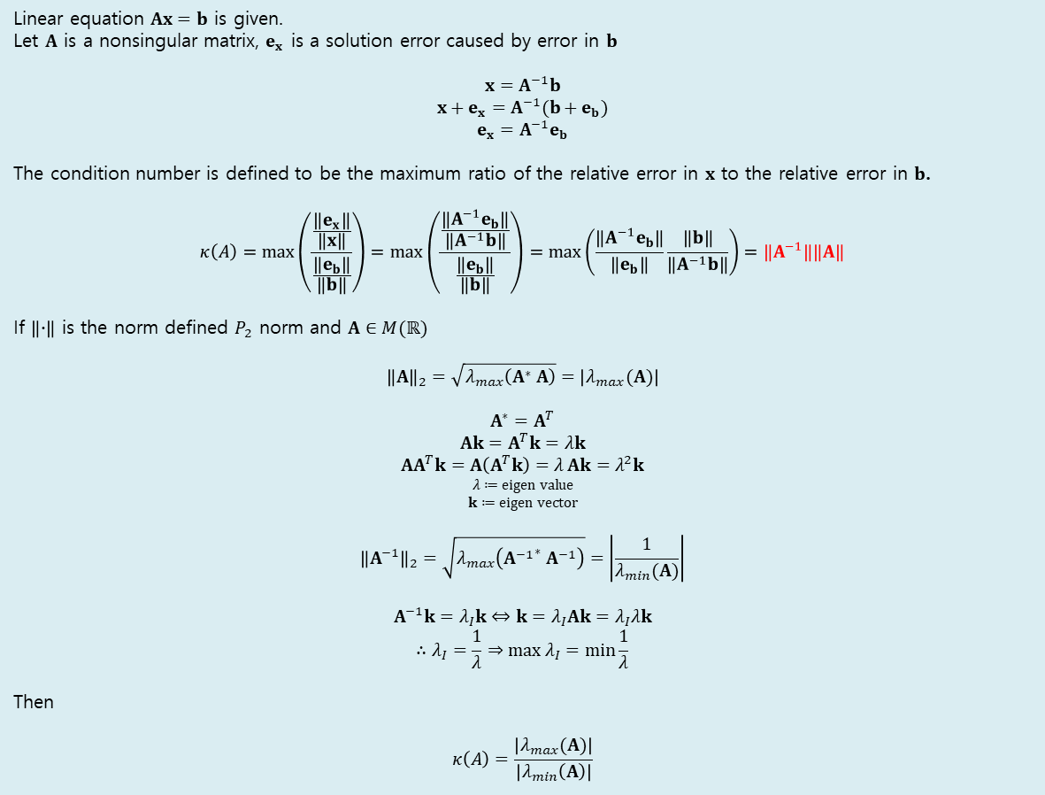
Condition Number of Linear Equation
Linear equation $Ax=b$ is given.
Let $A$ is a nonsingular matrix, $e_{x}$ is a solution error caused by error in $b$
$$x=A^{−1}b$$
$$x+e_{x}=A^{−1}(b+e_{b})$$
$$e_{x}=A^{−1}e_{b}$$
The condition number is defined to be the maximum ratio of the relative error in $x$ to the relative error in $b$.
$$κ\left(A\right)=\max\left(\frac{\frac{\left\|e_{x}\right\|}{‖x‖}}{\frac{\left\|e_{b}\right\|}{‖b‖}}\right)=\max\left(\frac{\frac{\left\|A^{−1}e_{b}\right\|}{‖A^{−1}b‖}}{\frac{\left\|e_{b}\right\|}{‖b‖}}\right)=\max\left(\frac{\left\|A^{−1}e_{b}\right\|}{‖e_{b}‖}\frac{\left\|b\right\|}{‖A^{−1}b‖}\right)=\left\|A^{−1}\right\|\left\|A\right\|$$
If $\left\|∙\right\|$ is the norm defined $P_{2}$ norm and $A∈M(ℝ)$
$${\left\|A\right\|}_{2}=\sqrt{λ_{max}\left(A^{∗} A\right)}=\left|λ_{max}(A)\right|$$
$$A^{∗}=A^{T}$$
$$Ak=A^{T}k=λk$$
$$AA^{T}k=A\left(A^{T}k\right)=λ_{ }Ak=λ_{ }^{2}k$$
$$λ≔eigen value$$
$$k≔eigen vector$$
$${\left\|A^{−1}\right\|}_{2}=\sqrt{λ_{max}\left({A^{−1}}^{∗} A^{−1}\right)}=\left|\frac{1}{λ_{min}(A)}\right|$$
$$A^{−1}k=λ_{I}k⇔k=λ_{I}Ak=λ_{I}λk$$
$$∴λ_{I}=\frac{1}{λ}⇒\max{λ_{I}}=\min{\frac{1}{λ}}$$
Then
$$κ\left(A\right)=\frac{\left|λ_{max}(A)\right|}{\left|λ_{min}\left(A\right)\right|}$$

Slide 24
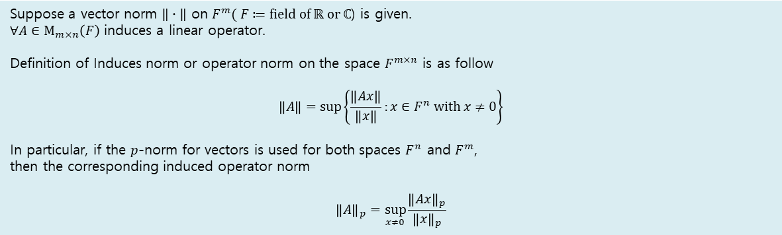
Suppose a vector norm $‖∙‖$ on $F^{m}( F≔field of ℝ or ℂ$) is given.
$∀A∈M_{m×n}\left(F\right)$ induces a linear operator.
Definition of Induces norm or operator norm on the space $F^{m×n}$ is as follow
$$\left\|A\right\|=\sup\left\{\frac{\left\|Ax\right\|}{\left\|x\right\|}:x∈F^{n} with x≠0\right\}$$
In particular, if the $p$-norm for vectors is used for both spaces $F^{n}$ and $F^{m}$,
then the corresponding induced operator norm
$${\left\|A\right\|}_{p}=\sup_{x≠0}{\frac{{\left\|Ax\right\|}_{p}}{{\left\|x\right\|}_{p}}}$$

Slide 25

Lagrange polynomial can be a basis of $ℙ$ ?
Let $ℙ^{n}$ be a $N th$ order polynomial vector space on field $F$.
Let $\dim{(ℙ^{n})}=k$.
Let $L=\left\{l^{\left(1\right)}, ⋯, l^{\left(k\right)}\right\}$ be a set of Lagrange polynomial and $a_{i}∈F$.
Then $L$ is basis of $ℙ^{n}$.
[PF]
Suppose that $L$ is linearly dependent.
$$l^{\left(j\right)}=\frac{1}{a_{j}}\sum_{\begin{aligned}i=1 \\ i≠j\end{aligned}}^{k}{a_{i}l^{\left(i\right)}}$$
When $x=x_{j}$ , $1=0$. contradict.
Thus $L$ is linearly independent.
$β^{ℙ^{n}}$ is a generating set of $ℙ^{n}$.
By linear algebra Thm 1.10, $L∪φ$ is generating set of $ℙ^{n}$.
Thus $L$ is generating set of $ℙ^{n}$.
Therefore $L$ is basis for $ℙ^{n}∎$

Slide 26

How to get Lagrange interpolation ?
Let $φ$ is basis for $ℙ_{n}$.
Let $\dim\left(ℙ_{n}\right)=k$.
Then $φ^{\left(i\right)}\left(x\right)=\sum_{1}^{k}{φ^{\left(i\right)}\left(x_{j}\right)l^{\left(j\right)}(x)}$. Hm it looks like linear transformation.
$$\left[\begin{matrix}\begin{matrix}φ_{1}\left(x_{1}\right) & \\ & \end{matrix} & \begin{matrix}⋯ & φ_{1}\left(x_{N_{β}}\right) \\ & \end{matrix} \\ \begin{matrix}\begin{aligned} \\ ⋮ \\ \end{aligned} & \\ \begin{aligned} \\ φ_{N_{β}}\left(x_{1}\right)\end{aligned} & \end{matrix} & \begin{matrix}\begin{aligned} \\ ⋮ \\ \end{aligned} & \begin{aligned} \\ ⋮ \\ \end{aligned} \\ ⋯ & φ_{N_{β}}\left(x_{N_{β}}\right)\end{matrix}\end{matrix}\right]\left[\begin{matrix}l^{\left(1\right)}\left(x\right) \\ \begin{aligned} \\ \end{aligned} \\ \begin{matrix} \\ \begin{aligned}⋮ \\ \end{aligned} \\ l^{\left(N_{β}\right)}\left(x\right)\end{matrix}\end{matrix}\right]=\left[\begin{matrix}φ_{1}\left(x\right) \\ \begin{aligned} \\ \end{aligned} \\ \begin{matrix} \\ \begin{aligned}⋮ \\ \end{aligned} \\ φ_{N_{β}}\left(x\right)\end{matrix}\end{matrix}\right]$$
$$VL=φ⇒ ∴L=V^{−1}φ$$
$$V≔generalized Vandermonde matrix$$
$$L≔Lagrange polynomial vector$$

Slide 27
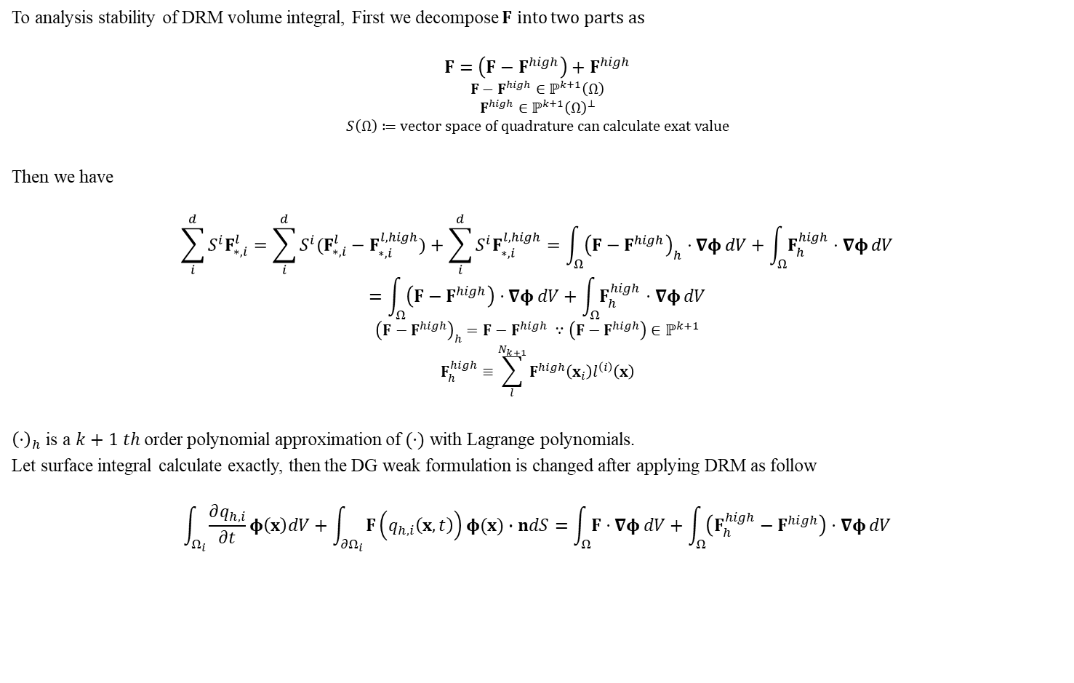
Stability of DRM
To analysis stability of DRM volume integral, First we decompose $F$ into two parts as
$$F=\left(F−F^{high}\right)+F^{high}$$
$$F−F^{high}∈ℙ^{k+1}\left(Ω\right)$$
$$F^{high}∈ℙ^{k+1}{\left(Ω\right)}^{⊥}$$
$$S\left(Ω\right)≔vector space of quadrature can calculate exat value$$
Then we have
$$\sum_{i}^{d}{S^{i}F_{∗,i}^{l}}=\sum_{i}^{d}{S^{i}(F_{∗,i}^{l}−F_{∗,i}^{l,high})}+\sum_{i}^{d}{S^{i}F_{∗,i}^{l,high}}=\int_{Ω}{{\left(F−F^{high}\right)}_{h}⋅∇φ}dV+\int_{Ω}{F_{h}^{high}⋅∇φ}dV$$
$$=\int_{Ω}{\left(F−F^{high}\right)⋅∇φ}dV+\int_{Ω}{F_{h}^{high}⋅∇φ}dV$$
$${\left(F−F^{high}\right)}_{h}=F−F^{high} ∵\left(F−F^{high}\right)∈ℙ^{k+1}$$
$$F_{h}^{high}≡\sum_{l}^{N_{k+1}}{F^{high}\left(x_{i}\right)l^{\left(i\right)}\left(x\right)}$$
${\left(⋅\right)}_{h}$ is a $k+1 th$ order polynomial approximation of $(⋅)$ with Lagrange polynomials.
Let surface integral calculate exactly, then the DG weak formulation is changed after applying DRM as follow
$$\int_{Ω_{i}}{\frac{∂q_{h,i}}{∂t}φ\left(x\right)dV}+\int_{{∂Ω}_{i}}{F\left(q_{h,i}\left(x,t\right)\right)φ(x)∙ndS}=\int_{Ω}{F⋅∇φ}dV+\int_{Ω}{\left(F_{h}^{high}−F^{high}\right)⋅∇φ}dV$$

